Slide 1
Cryptocurrency Analysis
By-Raunak Singh
Project on R Programming

Slide 2
INTRODUCTION
Index
No. | Contents
1 | Default Dataset
2 | Cleaned Dataset
3 | Summary
4 | Analysis #1
5 | Analysis #7
6 | Conclusion
Cryptocurrency experiences high volatility in prices, and analytics is useful in understanding this variations quantitatively and making strategic decisions.

Slide 3
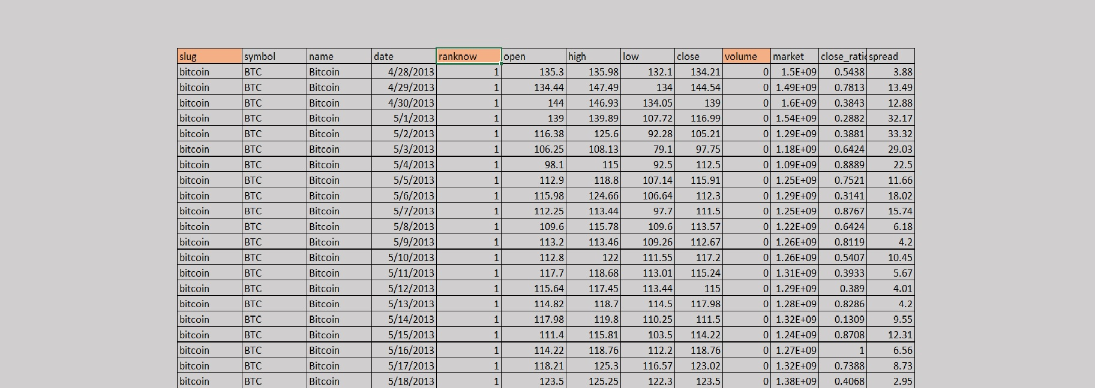
Default Dataset
Source-kaggle.com

Slide 4
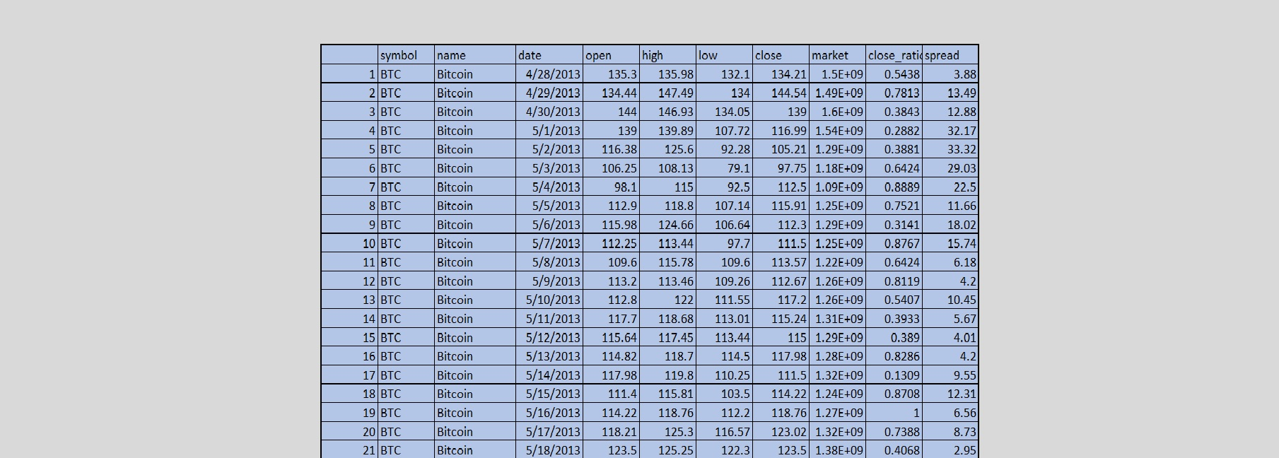
Cleaned Dataset
Source-kaggle.com

Slide 5
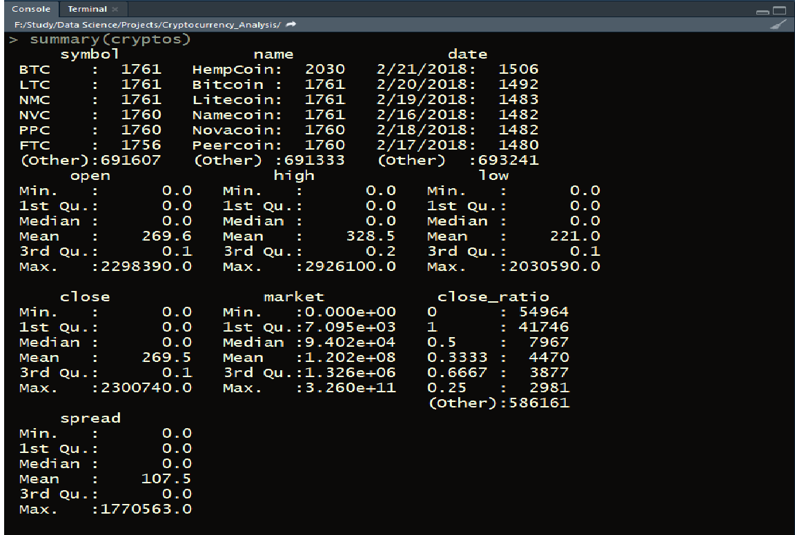
Summary

Slide 6
First cryptocurrency and its market variations from its debut year to 2018
Analysis #1

Slide 7
Code
q1<-cryptos[cryptos$name=='Bitcoin',]
bit2013<-q1[q1$year=='2013',]
mean(bit2013$market_in_crores) #303.1221
bit2014<-q1[q1$year=='2014',]
mean(bit2014$market_in_crores) #679.5851
bit2015<-q1[q1$year=='2015',]
mean(bit2015$market_in_crores) #391.6406
bit2016<-q1[q1$year=='2016',]
mean(bit2016$market_in_crores) #890.6763
bit2017<-q1[q1$year=='2017',]
mean(bit2017$market_in_crores) #6584.757
bit2018<-q1[q1$year=='2018',]
mean(bit2018$market_in_crores) #19505.77
df<-data.frame(Market=mean_market_bitcoin,Years=bitcoin_years)
mean_market_bitcoin<-c(303.1221,679.5851,391.6406,890.6763,6584.757,19505.77)
bitcoin_years<-c(2013,2014,2015,2016,2017,2018)
library(ggplot2)
graph<-ggplot(data=df,aes(x=bitcoin_years,y=mean_market_bitcoin))
graph + geom_bar(stat = "identity",fill=df$Years) +labs(x="Years",y="Bitcoin Market in Crores")

Slide 8
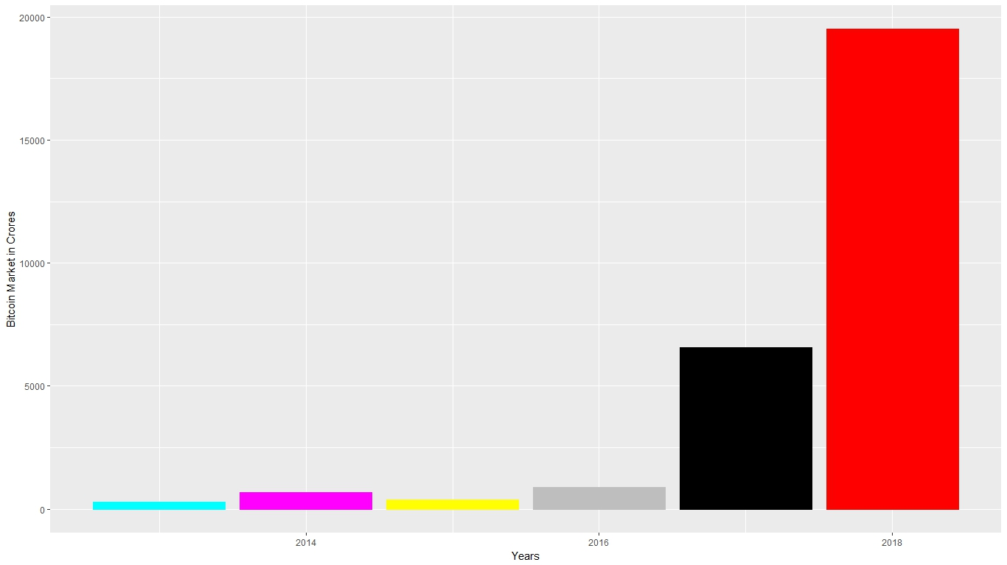
Bitcoin Market from 2013 to 2018(February)

Slide 9
Market variations of ripple from its peak value up to present scenario.
Analysis #2

Slide 10
Code
summary(cryptos[cryptos$name=='Ripple',])
q2<-cryptos[cryptos$name=="Ripple" & cryptos$market_in_crores==13000.000,]
q2
q21<-cryptos[cryptos$name=="Ripple" & cryptos$date>='2018-01-08',]
q21
marketq21<-q21$market_in_crores
max(marketq21)
market_range<-range(0,14000)
barplot(marketq21,ylab="Market",ylim=market_range,
main="Ripple Variations in Maket Value after reaching Peak Value",
xlab="Days",col.lab='Brown',cex.lab=1.4,col=rgb(0.1,0.2,0.3))

Slide 11
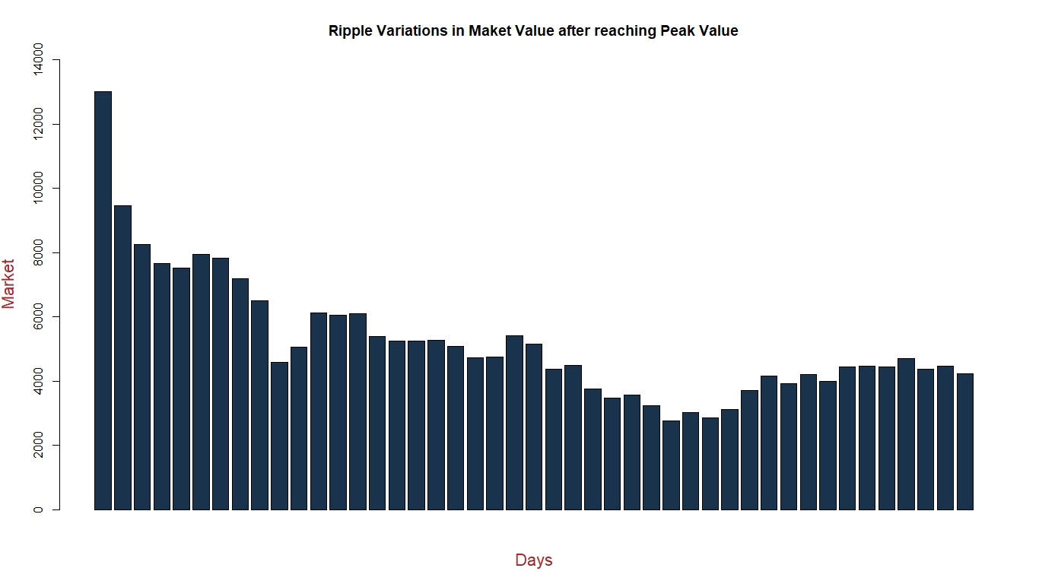

Slide 12
Which Cryptocurrency had the maximum spread in 2017?
Analysis #3

Slide 13
Code
cryptos$year<-substring(cryptos$date,1,4)
table(cryptos$year & cryptos$spread)
max_spread<-cryptos[cryptos$year =='2017',]
install.packages("treemap")
library('treemap')
treemap(max_spread,index = 'name',vSize = 'spread',title = 'Cryptocurrency Spread in 2017',
vColor = 'spread',fontsize.labels=10,palette = "RdYlBu")

Slide 14
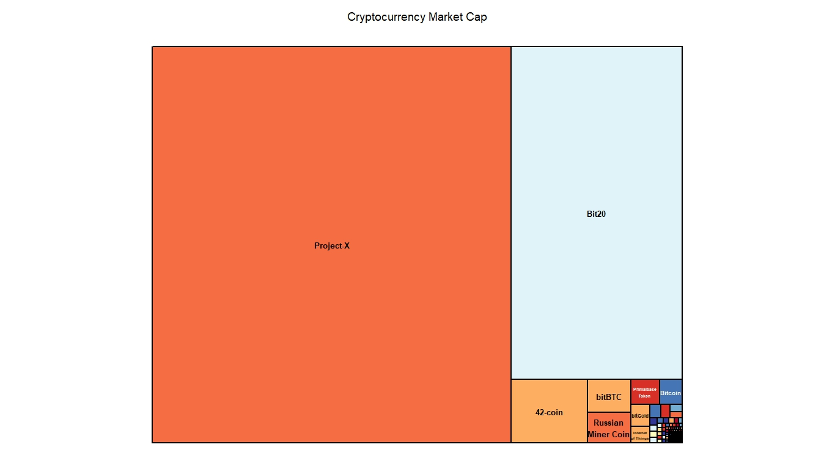

Slide 15
Understanding the change of Bitcoin price with its spread
Analysis #4

Slide 16
Code
bitcoin<-cryptos[cryptos$name=="Bitcoin",]
bitcoin_spread<-bitcoin$spread
bitcoin_value<-bitcoin$close
library("ggplot2")
ggplot(bitcoin,aes(x=bitcoin_value,y=bitcoin_spread,colour=bitcoin$year))
+geom_point(size=5,alpha=0.8)+geom_smooth(method = 'lm',aes(fill=bitcoin$year))

Slide 17
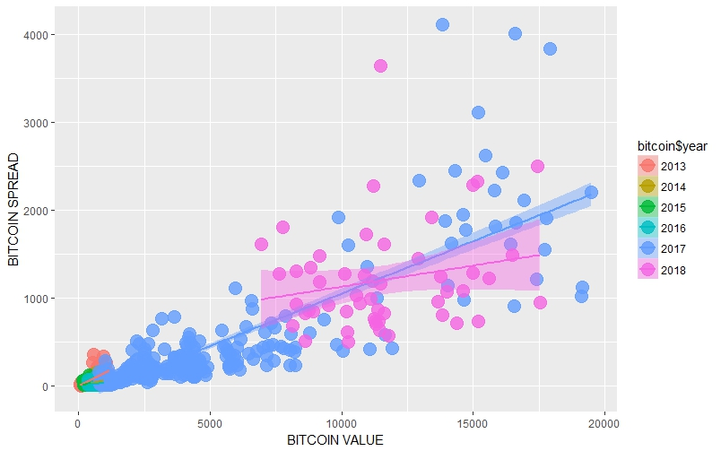

Slide 18
Top 5 Crptocurrencies with difference in their price from beginning to current time.
Analysis #5

Slide 19
Code
install.packages("coinmarketcapr")
library("coinmarketcapr")
plot_top_5_currencies()
bitcoin<-cryptos[cryptos$name=="Bitcoin",]
bitcoin_cash<-cryptos[cryptos$name=="Bitcoin Cash",]
EOS<-cryptos[cryptos$name=="EOS",]
Ethereum<-cryptos[cryptos$name=="Ethereum",]
Ripple<-cryptos[cryptos$name=="Ripple",]
top_5<-rbind(bitcoin,bitcoin_cash,EOS,Ethereum,Ripple)
library(ggplot2)
ggplot(top_5,aes(x=name,y=close,colour=year))+geom_point(size=5,alpha=0.8)
+geom_smooth(method = 'lm',aes(fill=year))

Slide 20
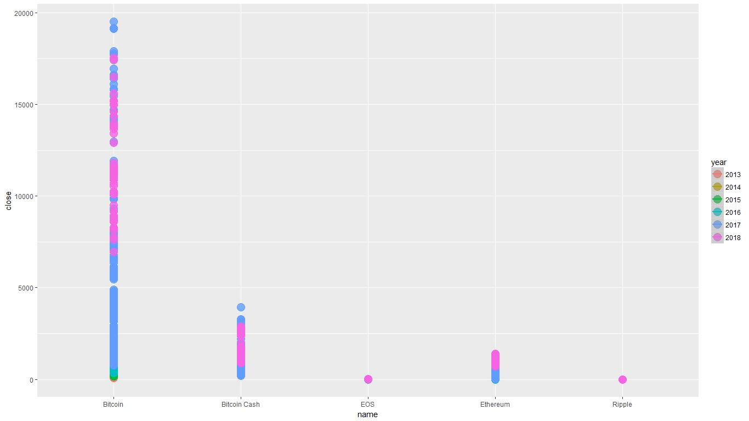

Slide 21
Difference in Currencies with the name of Bitcoins
Analysis #6

Slide 22
Code
hello<-cryptos[grep("Bitcoin",cryptos$name),]
library(treemap)
treemap(hello,index = 'name',vSize = 'spread',title = 'Other Bitcoins Spread in 2017',
vColor = 'market',fontsize.labels=12,palette = "RdYlBu")

Slide 23
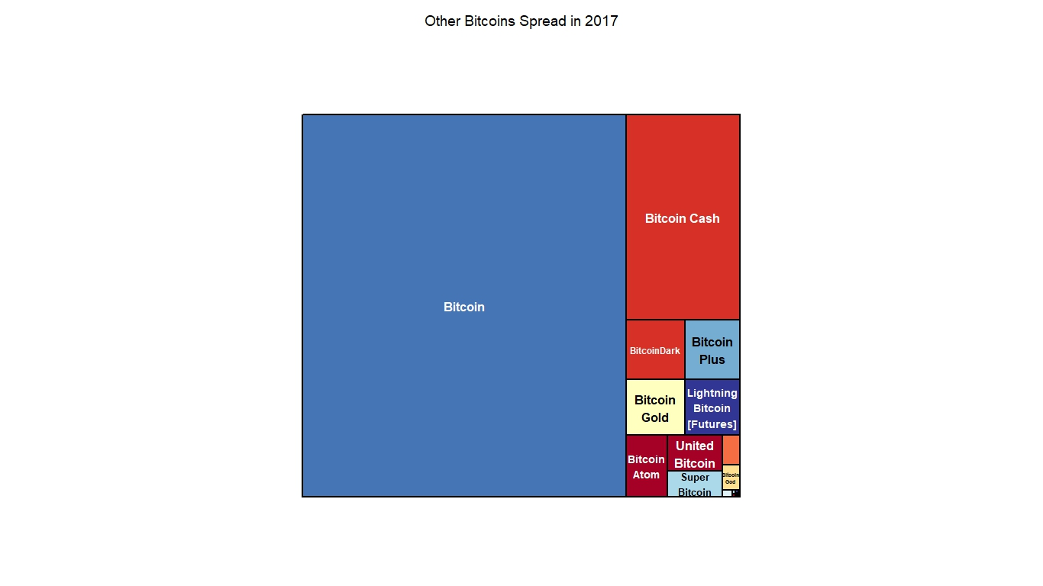

Slide 24
CONCLUSION
References
www.kaggle.com
www.stackoverflow.com
www.rfunction.com
After completing the project, I got to understand crypto dynamos more closely and their behavior with respect to time, market value, spread, etc.
After the analysis many results were unexpected, so you never know the cryptocurrency variations.

